Slide 1
RECRUITEX

Slide 2

Every student keeps on aspiring to get a good job in a prestigious company but they are not aware of the jobs that are available in those companies.So, we came up with an idea of online recruiting website that is RECRUITEX.

Slide 3







IMPLEMENTATION
BACKEND
FRONTEND
MYSQL
HIBERNATE
RESTAPI
ANGULAR
HTML
CSS
BOOTSTRAP

Slide 4






MODULES
Login and Register
Recruiter and User
Add Courses and Jobs
Upload Files
Display Files
Profile

Slide 5
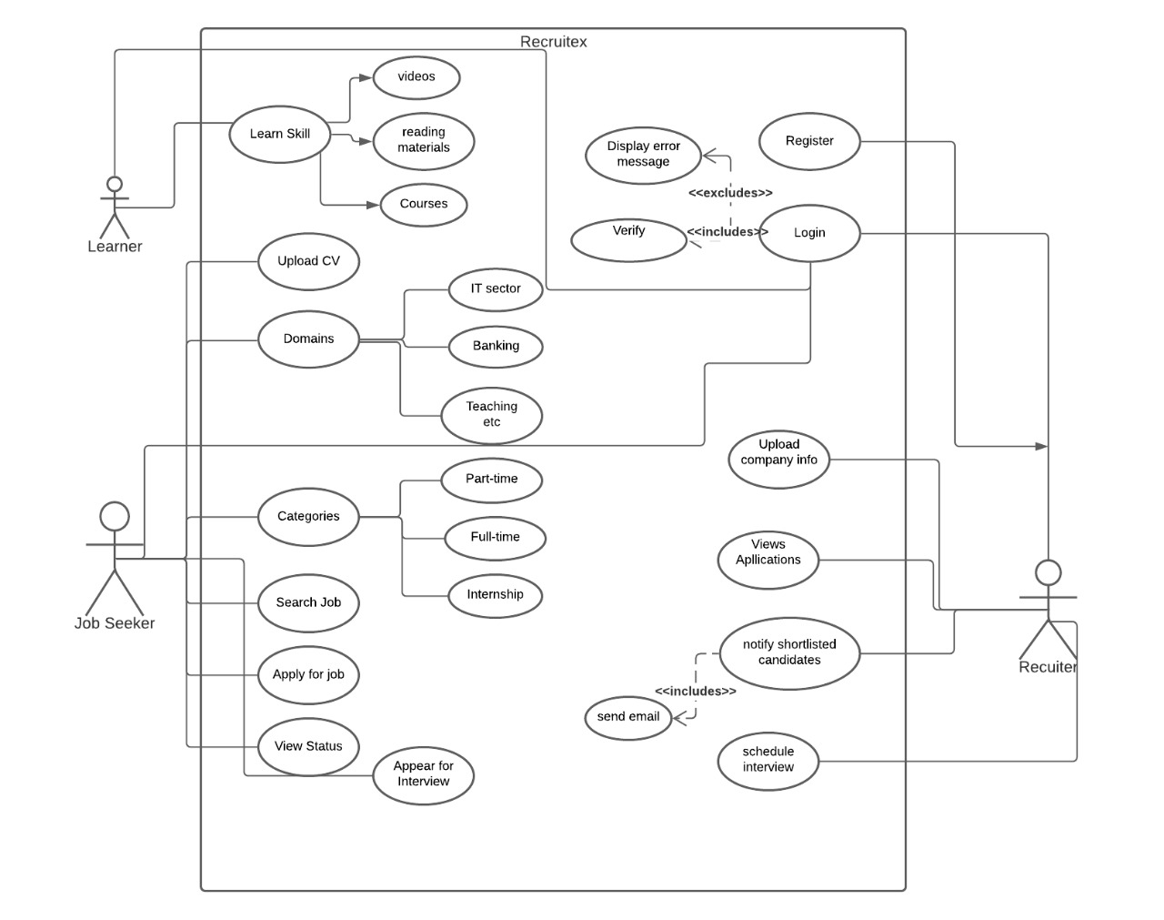
USECASE DIAGRAM

Slide 6
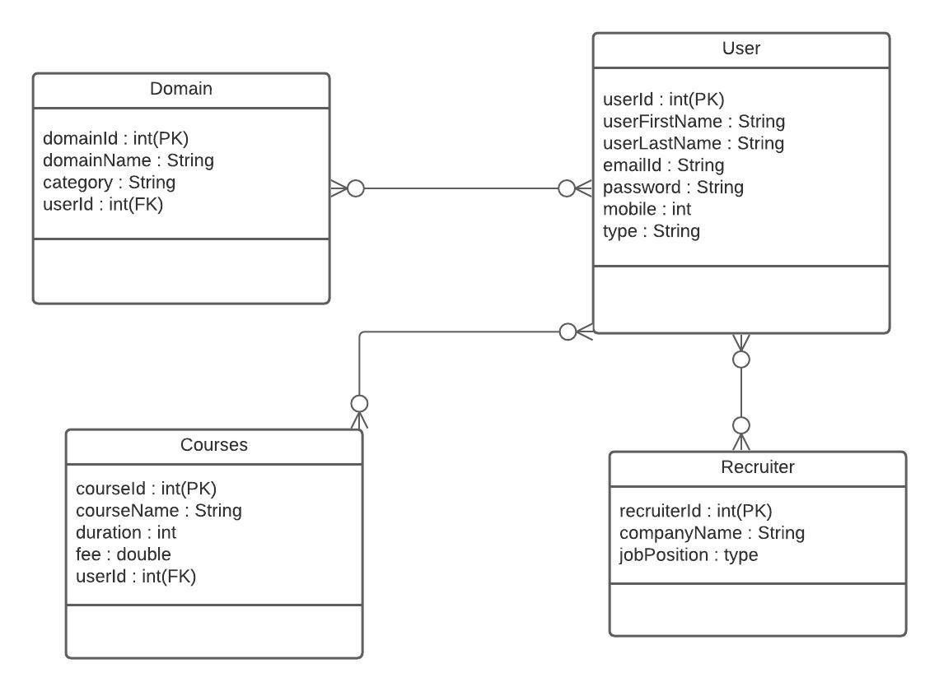
CLASS DIAGRAM

Slide 7
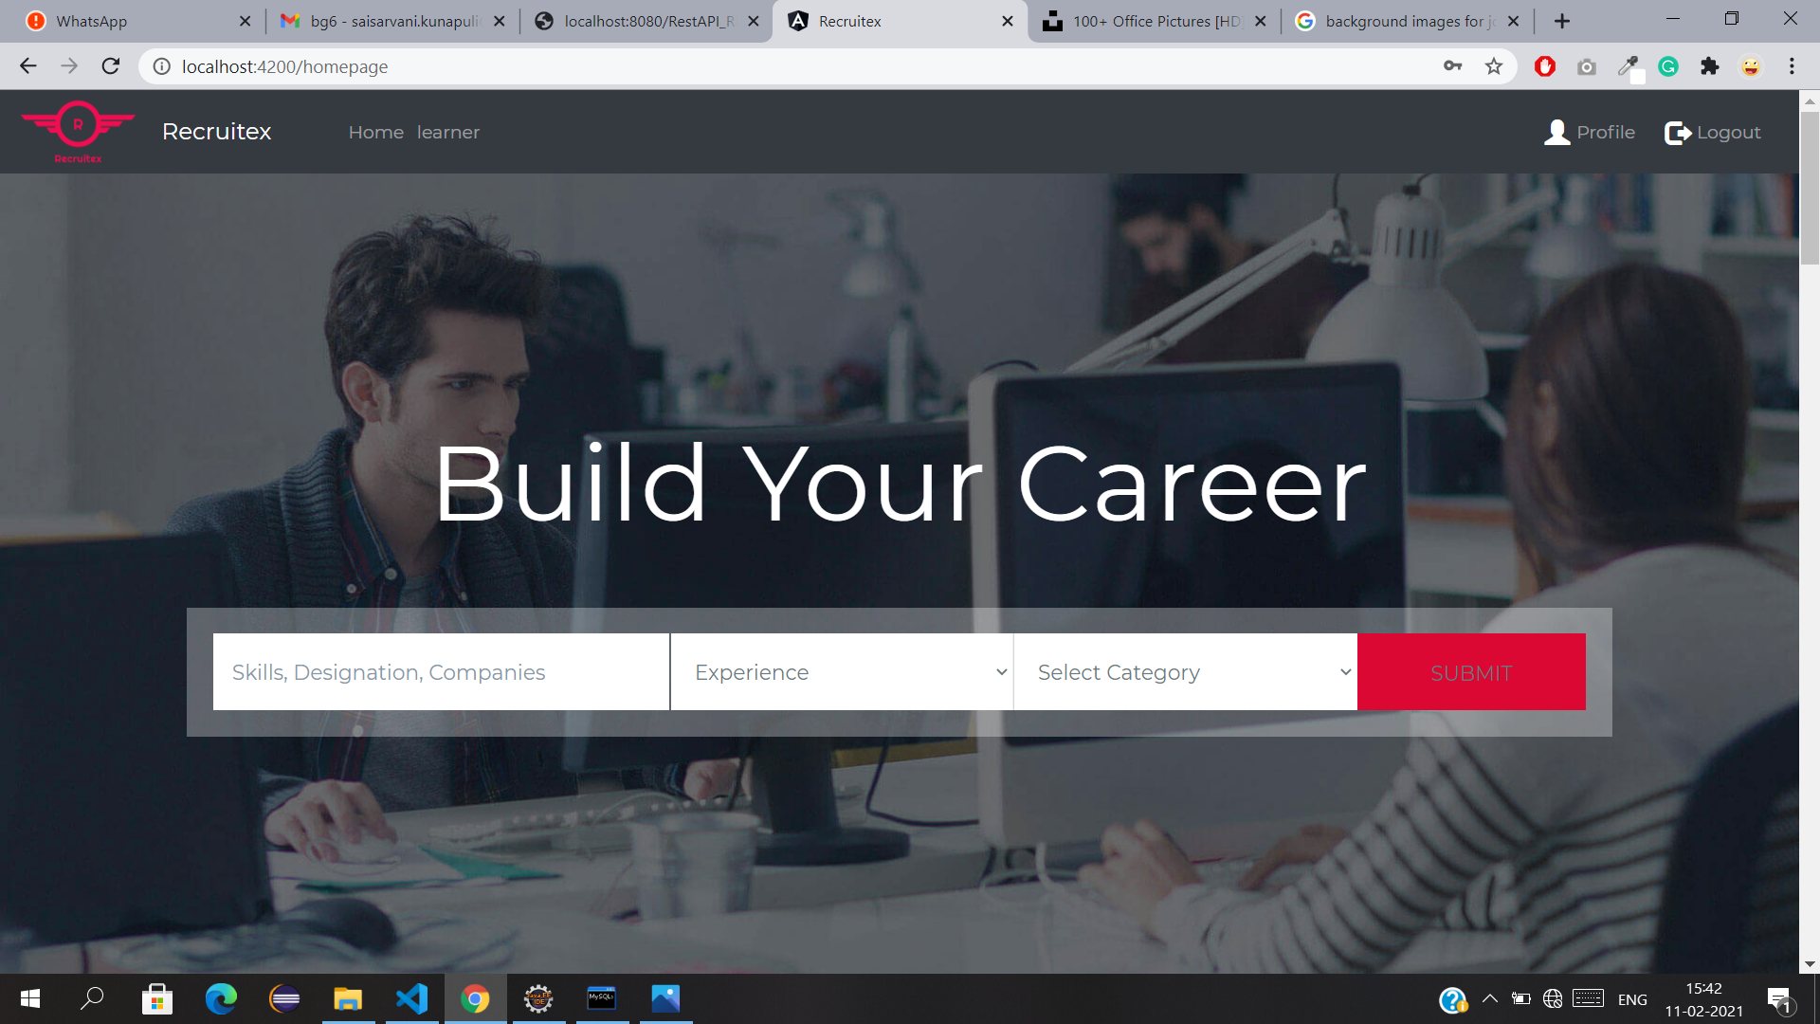

Home Page

Slide 8
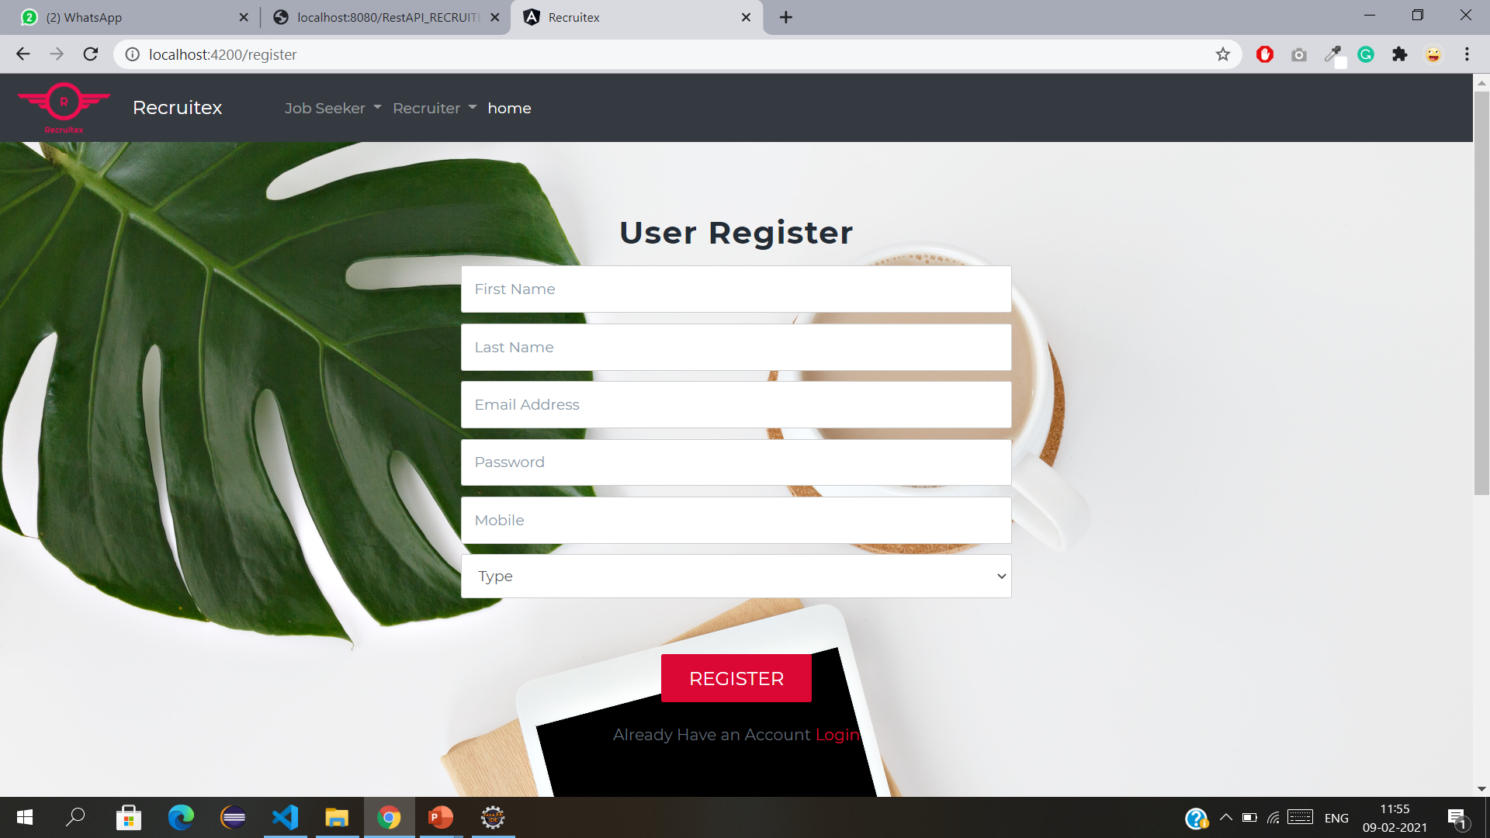
Login and Register

Slide 9
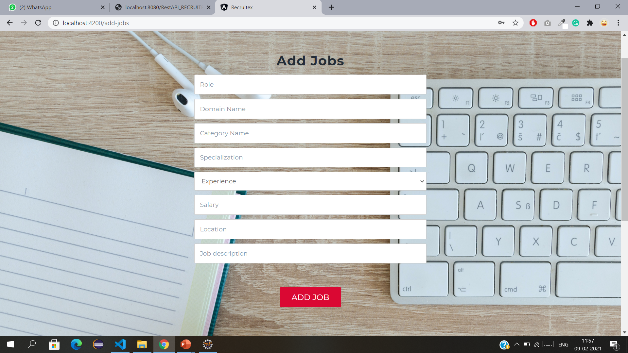
Add Jobs, Courses

Slide 10
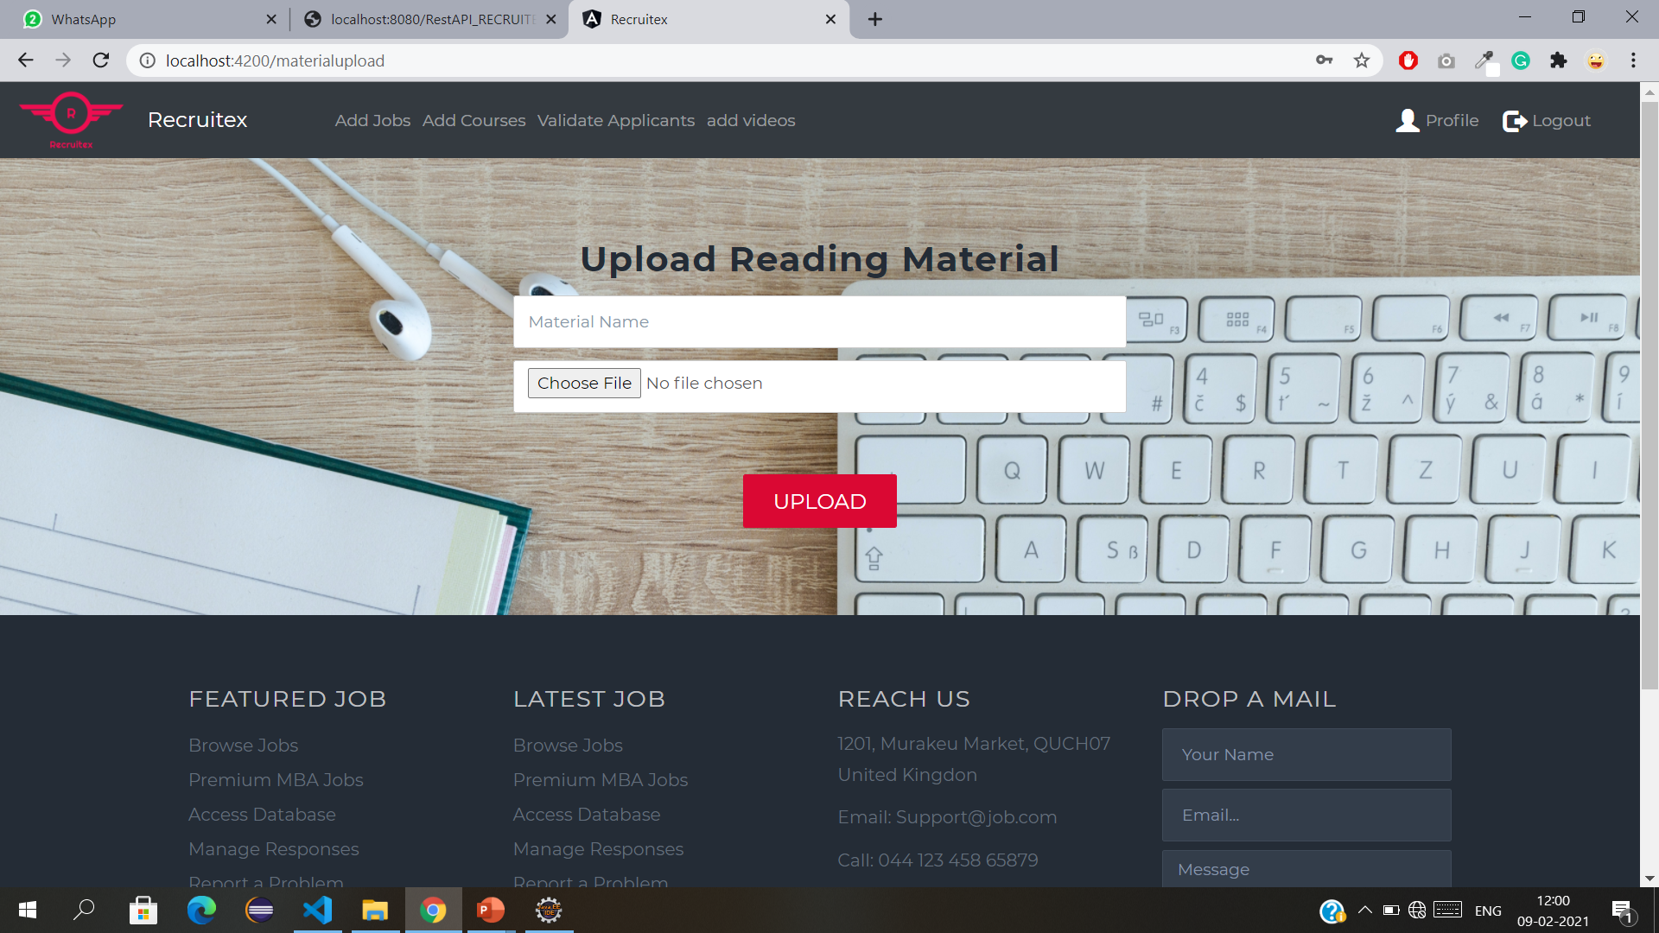
Upload Files

Slide 11
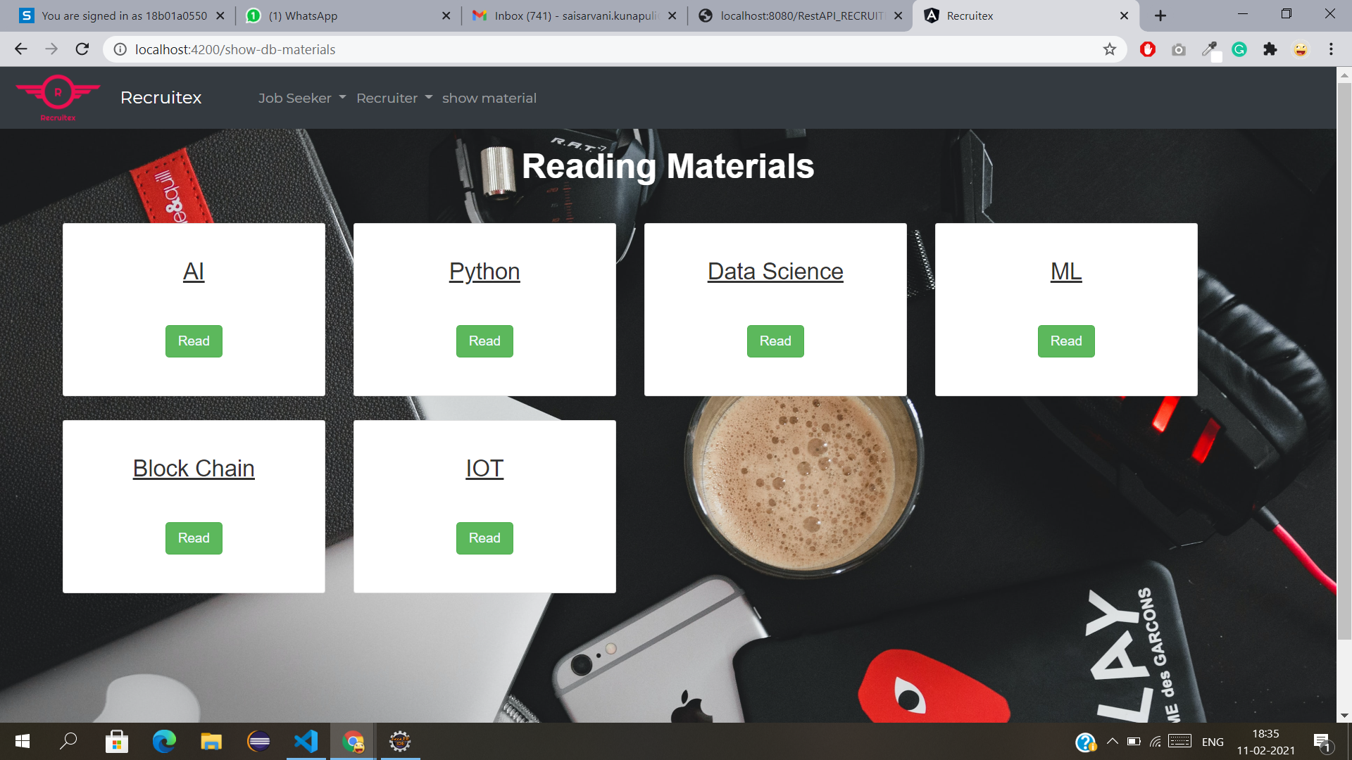
Display Files

Slide 12

https://github.com/Wiseangular/RecruitexProject

Slide 13


File Upload
Header Routing
Communication
CHALLENGES

Slide 14

The Project “Recruitex” successfully implemented all features mentioned in software requirement specifications.
This project is developed by keeping the view of problems faced by jobseekers in searching for a good job.

Slide 15
THANK YOU!

